Slide 1
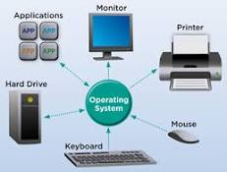
Computer Peripherals

Slide 2
Operating System means what?
An operating system is the most important software that runs on a computer and Mobile. It manages the computer's memory and processes, as well as all of its software and hardware.

Slide 3
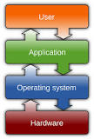
Role of Operating System

Slide 4
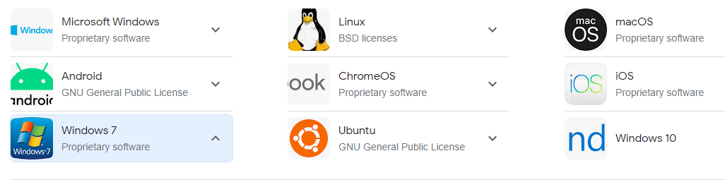
Some Popular Operating Systems

Slide 5
Number System
Binary
Range – (0-1)₂
Base Value - 2

Slide 6
Number System
Decimal
Range – (0-9)₁₀
Base Value - 10

Slide 7
Number System
Octal
Range – (0-7)₈
Base Value - 8
Hexa-Decimal
Range – (0-15)₁₆
Base Value - 16
0-9, 10-a,11-b,12-c,13-d,14-e and 15-f

Slide 8
ASCII Value
A B C…… …….. ….Z
ASCII=>American Standard Code for Information Interchange
65
66
67
90
a b c …………… ……………….. ……… z
97
98
99
122

Slide 9
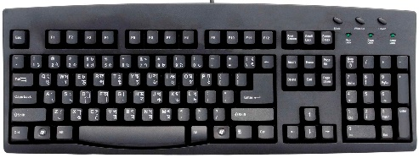
ASCII Range(0-255)
KEYBOARD TOTAL KEYS (104)
Upper case (65-90)
Lower case (97-122)
Numbers (48-57)
Special Characters & Symbols
(0-47,58-64,91-96,123-255)
This Photo by Unknown Author is licensed under CC BY-SA

Slide 10
Computer Memory Types
1. Primary Memory :- Primary Memory is a section of computer memory that the CPU can access directly.
2. Secondary memory :- computer memory that is non-volatile, persistent and not immediately accessible by a computer or processor.

Slide 11
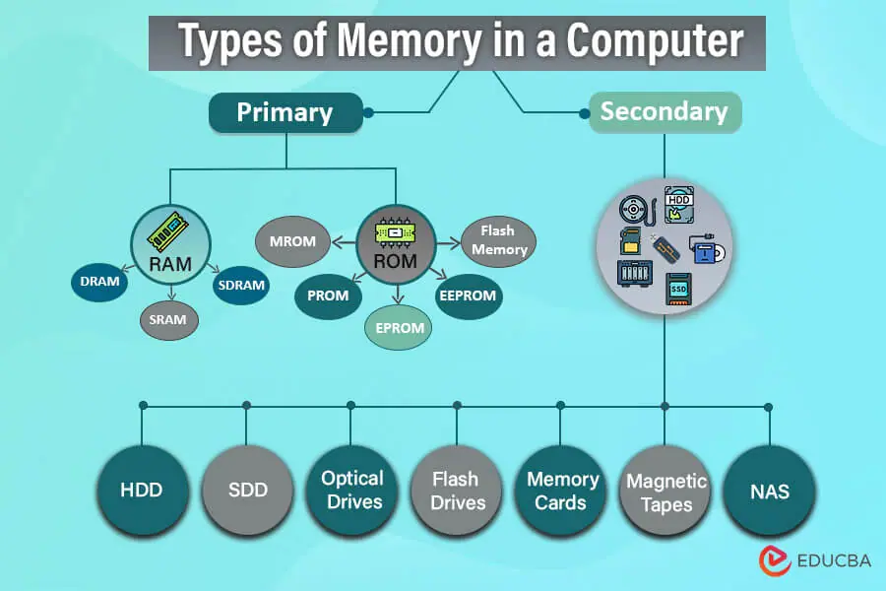
Explanation using graphics

Slide 12
RAM
RAM(RANDOM ACCESS MEMORY)
DRAM(Dynamic Random Access Memory)
SRAM(Static Random Access Memory)
SDRAM(Synchronous Dynamic Random Access Memory)

Slide 13
ROM
ROM(READ ONLY MEMORY)
MROM(Masked Read-only memory)
PROM(Programmable Read-only memory)
EPROM(Erasable programmable read-only memory)
FLASH MEMORY
EEPROM(Electrically Erasable Programmable Read-Only Memory)

Slide 14
SECONDARY MEMORY
HDD(Hard Disk Drive)
SDD(Solid State Drive)
SSD(Solid State Drive)
USB(Universal Serial Bus )
OPTICAL DRIVES
FLASH DRIVES
MEMORY CARD
MAGNATIC TAPES

Slide 15


THANK YOU VERY MUCH FOR WATCHING THIS VIDEO

